Slide 1
Client-Side Development in ASP.NET Core

Slide 2
Client Side Web technologies
ASP.NET Core MVC Web applications typically rely on client-side web
technologies like HTML, CSS, and JavaScript. By separating the content of the
page (the HTML) from its layout and styling (the CSS), and its behavior (via
JavaScript), complex web apps can leverage the Separation of Concerns
principle and future modifications to the structure, design, or behavior of the
application can be made more easily.
HTML (Hyper Text Markup Language):
HTML (HyperText Markup Language) is the most basic building block of the Web.
"Hypertext" refers to links that connect web pages to one another, either within a single website or between websites. Links are a fundamental aspect of the Web. By uploading content to the Internet and linking it to pages created by other people, you become an active participant in the World Wide Web.
It is the standard markup language used to create web pages and web applications. Its elements form the building blocks of pages, representing formatted text, images, form inputs, and other structures. When a browser makes a request to a URL, whether fetching a page or an application, the first thing that is returned is an HTML document. This HTML document may reference or include additional information about its look and layout in the form of CSS, or behavior in the form of JavaScript.

Slide 3
Basic HTML Document
<!DOCTYPE html>
<html>
<head>
<title>This is document title</title>
</head>
<body>
<h1>This is a heading</h1>
<p>Hello World !</p>
</body>
</html>
How Does HTML Work ?
HTML documents are files that end with a .html or .htm extension. You can view then
using any web browser (such as Google Chrome, Safari, or Mozilla Firefox). The
browser reads the HTML file and renders its content so that internet users can view it.

Slide 4
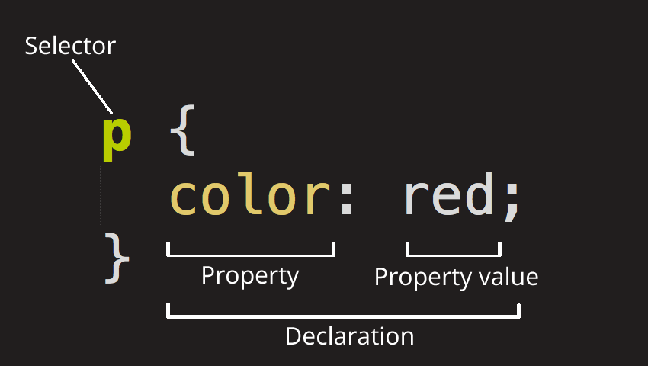
CSS:
Cascading Style Sheets (CSS) is a stylesheet language used to describe the presentation of a document written in HTML or XML (including XML dialects such as SVG, MathML or XHTML). CSS describes how elements should be rendered on screen, on paper, in speech, or on other media.
CSS is used to control the look and layout of HTML elements. CSS styles can be applied directly to an HTML element, defined separately on the same page, or defined in a separate file and referenced by the page.

Slide 5
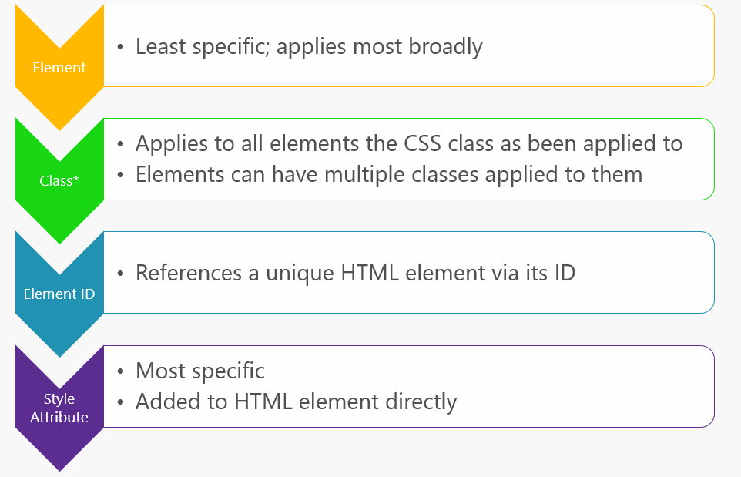
CSS Specificity rules, in order

Slide 6
JavaScript:
JavaScript is a dynamic, interpreted programming language that has been standardized in the ECMAScript language specification. It is the programming language of the web. Like CSS, JavaScript can be defined as attributes within HTML elements, as blocks of script within a page, or in separate files. Just like CSS, it's recommended to organize JavaScript into separate files, keeping it separated as much as possible from the HTML found on individual web pages or application views.
When working with JavaScript in your web application, there are a few tasks that you'll
commonly need to perform:
Selecting an HTML element and retrieving and/or updating its value.
Querying a Web API for data.
Sending a command to a Web API (and responding to a callback with its
result).
Performing validation.
React to events
Animate and Add Effects

Slide 7
Adding JavaScript into an HTML Document
The <script> tag can be placed in the <head> section of your HTML or in the <body> section,
depending on when you want the JavaScript to load.
Generally, JavaScript code can go inside of the document <head> section in order to keep them contained and out of the main content of your HTML document.
<!DOCTYPE html>
<html lang="en-US">
<head>
<meta charset="UTF-8">
<title>Basic</title>
<script type="text/javascript">
document.write("Hello Javascript");
</script>
</head>
<body>
</body>
</html>

Slide 8
Working with a Separate JavaScript File
In order to accommodate larger scripts or scripts that will be used across several pages, JavaScript code generally lives in one or more js files that are referenced within HTML documents.
<script src="js/script.js"></script>
The benefits of using a separate JavaScript file include:
Separating the HTML markup and JavaScript code to make both more straightforward
Separate files makes maintenance easier
When JavaScript files are cached, pages load more quickly

Slide 9
Javascript Examples
1) Display Text
<script type="text/javascript">
document.write("Hello world!");
</script>
the document.write method will overwrite all the text on the page. A much more useful method is document.getElementById. document.getElementById enables you to update or change the text in an element easily without affecting the rest of the page, as shown below.
<script type="text/javascript">
document.getElementById("myelement1") = "Hello world!";
</script>

Slide 10
Javascript Array
<script>
var i;
var std = new Array();
std[0] = “Ram";
std[1] = “Shyam";
std[2] = “Raju";
for (i=0;i<emp.length;i++){
document.write(emp[i] + "<br>");
}
</script>
JavaScript array constructor (new keyword)
<script>
var emp=new Array(“Ram", “Shyam", “Raju");
for (i=0;i<emp.length;i++){
document.write(emp[i] + "<br>");
}
</script>

Slide 11
JavaScript String
String literal
<script>
var str="This is string literal";
document.write(str);
</script>
string object
<script>
var stringname=new String("hello world");
document.write(stringname);
</script>

Slide 12
JavaScript Functions
<script>
function getMessage(){
Return “Hi there, Welcome";
}
</script>
<script>
document.write(getMessage());
</script>
Advantages of JavaScript functions.
Code reusability: you can call a function several times so it save coding.
Less coding: It makes your program compact. you don’t need to write many lines of
code each time to perform a common task.

Slide 13
Javascript Events
The change in the state of an object is known as an Event. In html, there are various events which represents that some activity is performed by the user or by the browser. When javascript code is included in HTML, js react over these events and allow the execution. This process of reacting over the events is called Event Handling. Thus, js handles the HTML events via Event Handlers.
For example, when a user clicks over the browser, add js code, which will execute the
task to be performed on the event.
We can categories Javascript events on:
Document Level Events – onload, onunload
Form Level Events- onsubmit, onreset, onchange,onselect, onblur, onfocus
Keyboard Events- onkeydown, onkeypress, onkeyup
Mouse Events- onclick, ondblclick, onmouseover, onmouseout
<script language="Javascript" type="text/Javascript">
function clickevent()
{
document.write(“ Hi");
}
</script>
<form>
<input type="button" onclick="clickevent()" value=“click me ?"/>
</form>

Slide 14

HTML DOM
The Document Object Model (DOM) is a cross-platform and language-independent interface that treats an XML or HTML document as a tree structure wherein each node is an object representing a part of the document. The DOM represents a document with a logical tree. Each branch of the tree ends in a node, and each node contains objects. DOM methods allow programmatic access to the tree; with them one can change the structure, style or content of a document. Nodes can have event handlers attached to them. Once an event is triggered, the event handlers get executed.

Slide 15
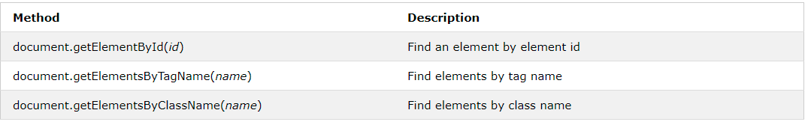
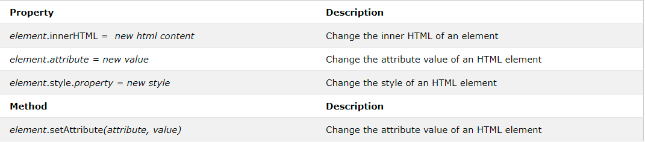
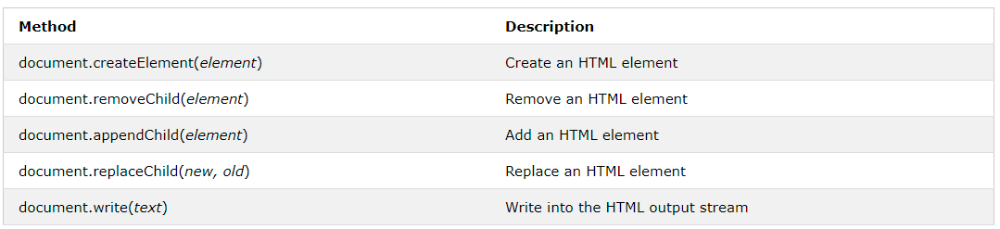

Slide 16
Javascript Form Validation
JavaScript provides a way to validate form's data on the client's computer before sending it to the web server. Form validation generally performs two functions.
Basic Validation − First of all, the form must be checked to make sure all the mandatory fields are filled in. It would require just a loop through each field in the form and check for data.
Data Format Validation − Secondly, the data that is entered must be checked for correct form and value. Your code must include appropriate logic to test correctness of data.

Slide 17
<script type = "text/javascript">
function validate() {
if( document.StudentForm.Name.value == "" ) {
alert( "Please provide your name!" );
document.StudentForm.Name.focus() ;
return false;
}
if( document.StudentForm.Email.value == "" ) {
alert( "Please provide your Email!" );
document.StudentForm.Email.focus() ;
return false;
}
if( document.StudentForm.Zip.value == "" || isNaN( document.StudentForm.Zip.value ) ||
document.StudentForm.Zip.value.length != 5 ) {
alert( "Please provide a zip in the format #####." );
document.StudentForm.Zip.focus() ;
return false;
}
if( document.StudentForm.Country.value == "-1" ) {
alert( "Please provide your country!" );
return false;
}
return true;
}
</script>

Slide 18
jQuery
jQuery is a fast, small and feature-rich JavaScript library included in a single .js file.
jQuery makes a web developer's life easy. It provides many built-in functions using which you can accomplish various tasks easily and quickly.
jQuery Important Features
DOM Selection: jQuery provides Selectors to retrieve DOM element based on different criteria like tag name, id, css class name, attribute name, value, nth child in hierarchy etc.
DOM Manipulation: You can manipulate DOM elements using various built-in jQuery functions. For example, adding or removing elements, modifying html content, css class etc.
Special Effects: You can apply special effects to DOM elements like show or hide elements, fade-in or fade-out of visibility, sliding effect, animation etc.
Events: jQuery library includes functions which are equivalent to DOM events like click, dblclick, mouseenter, mouseleave, blur, keyup, keydown etc. These functions automatically handle cross-browser issues.
Ajax: jQuery also includes easy to use AJAX functions to load data from servers without reloading whole page.
Cross-browser support: jQuery library automatically handles cross-browser issues, so the user does not have to worry about it.

Slide 19
Advantages of jQuery
Easy to learn: jQuery is easy to learn because it supports same JavaScript style coding.
Write less do more: jQuery provides a rich set of features that increase developers' productivity by writing less and readable code.
Excellent API Documentation: jQuery provides excellent online API documentation.
Cross-browser support: jQuery provides excellent cross-browser support without writing extra code.
Unobtrusive: jQuery is unobtrusive which allows separation of concerns by separating html and jQuery code.

Slide 20
Start using jQuery
There are several ways to start using jQuery on your web site. You can:
Download the jQuery library from jQuery.com
Include jQuery from a CDN, like Google
There are two versions of jQuery available for downloading:
Production version - this is for your live website because it has been minified and compressed
Development version - this is for testing and development (uncompressed and readable code)
Both versions can be downloaded from jQuery.com.
The jQuery library is a single JavaScript file, and can be referenced with the HTML <script> tag ( that the <script> tag should be inside the <head> section):

Slide 21
<head>
<script src="jquery-3.5.1.min.js"></script>
</head>
If you don't want to download and host jQuery yourself, you can include it from a CDN (Content Delivery Network).
jQuery hosted on google:
<head>
<script src="https://ajax.googleapis.com/ajax/libs/jquery/3.5.1/jquery.min.js"></script>
</head>

Slide 22
The jQuery syntax is suited for selecting HTML elements and performing some action on the element(s).
Basic syntax is: $(selector).action()
A $ sign to define/access jQuery
A (selector) to "query (or find)" HTML elements
A jQuery action() to be performed on the element(s)
Examples:
$(this).hide() - hides the current element.
$("p").hide() - hides all <p> elements.
$(".links").hide() - hides all elements with class="links".
$("#resetButton").hide() - hides the element with id= "resetButton".

Slide 23
The Document Ready Event
Before you can safely use jQuery to do anything to your page, you need to ensure that the page is in a state where it's ready to be manipulated. With jQuery, it can be accomplished by putting your code in a function, and then passing that function to $(document).ready()
$(document).ready(function(){
// jQuery methods
});
To prevent any jQuery code from running before the document is finished loading (is
ready). It is good practice to wait for the document to be fully loaded and ready before working with it.
Actions that can be failed if methods are run before the document is fully loaded:
Trying to hide an element that is not created yet
Trying to get the size of an image that is not loaded yet

Slide 24
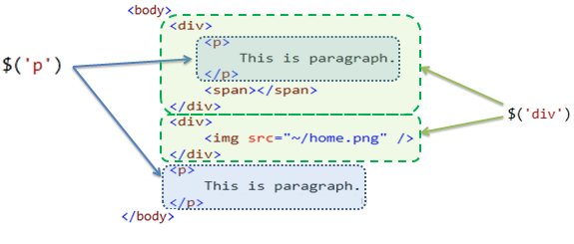
jQuery Selectors
The jQuery selector enables you to find DOM elements in your web page. Most of the times you will start with selector function $() in the jQuery.
$(document).ready(function(){
$(“#button").click(function(){
$("p").hide();
});
});

Slide 25
The #id Selector
The jQuery #id selector uses the id attribute of an HTML tag to find the specific element.
$("#closeBtn")
The .class Selector
The jQuery .class selector finds elements with a specific class.
$(".test")
$("*") Selects all elements
$(this) Selects the current HTML element
$("p.intro") Selects all <p> elements with class="intro"
$("p:first") Selects the first <p> element
$("ul li:first") Selects the first <li> element of the first <ul>
$("ul li:first-child") Selects the first <li> element of every <ul>
$("[href]") Selects all elements with an href attribute

Slide 26
jQuery Events
jQuery events are the actions that can be detected by your web application. An event shows the exact moment when something happens.
These are some examples of events.
A mouse click
An HTML form submission
A web page loading
A keystroke on the keyboard
Scrolling of the web page etc.
Most of the DOM events have an equivalent jQuery method. To assign a click events to all paragraph on a page. $("p").click();
bind a click event on a button
$("btn").click( function () {
// do something
});

Slide 27
Submit a Form Using jQuery
<script src="https://code.jquery.com/jquery-3.5.1.min.js"></script>
<script>
$(document).ready(function() {
$("#regBtn").click(function() {
$(“#studnetForm").submit(); // Submit the form
});
});
</script>
<form action=“/student/save" method="post" id=“studentForm">
<label>First Name:</label>
<input type="text" name="first-name">
<label>Last Name:</label>
<input type="text" name=“last-name">
<button type="button" id=“regBtn">Submit Form</button>
</form>

Slide 28
Form Validation With jQuery
Using a jQuery plugin to validate forms serves a lot of purposes. It gives you additional abilities like easily displaying custom error messages and adding conditional logic to form validation. A validation library can also help you add validation to your HTML forms with minimal or no changes to the markup. The conditions for validity can also be added, removed, or modified at any time with ease.
<script src="https://cdnjs.cloudflare.com/ajax/libs/jquery/3.4.0/jquery.min.js"></script>
<script src="https://cdnjs.cloudflare.com/ajax/libs/jquery-validate/1.19.0/jquery.validate.min.js"></script>
<form id="basic-form" action="" method="post">
<p>
<label for="name">Name <span>(required, at least 3 characters)</span></label>
<input id="name" name="name" minlength="3" type="text" required>
</p>
<p>
<label for="email">E-Mail <span>(required)</span></label>
<input id="email" type="email" name="email" required>
</p>
<p>
<input class="submit" type="submit" value="SUBMIT">
</p>
</form>
To start validating the form with this plugin, simply add the following JavaScript code on the webpage:
$(document).ready(function() {
$("#basic-form").validate();
});

Slide 29
Add Validation Rules for Input Fields
You can also pass some rules to the validate() method in order to determine how the input values are validated. The value of the rules parameter should be an object with key-value pairs. The key in each case is the name of the element that we want to validate. The value of that key is an object which contains a set of rules which will be used for validation.
$(document).ready(function() {
$("#basic-form").validate({
rules: {
name : {
required: true,
minlength: 3
},
age: {
required: true,
number: true,
min: 18
},
email: {
required: true,
email: true
},
weight: {
required: {
depends: function(elem) {
return $("#age").val() > 50
}
},
number: true,
min: 0
}
}
});
});

Slide 30
Legacy web apps with jQuery
Although ancient by JavaScript framework standards, jQuery continues to be a commonly used library for working with HTML/CSS and building applications that make AJAX calls to web APIs. However, jQuery operates at the level of the browser document object model (DOM), and by default offers only an imperative, rather than declarative, model.
For example, imagine that if a textbox's value exceeds 10, an element on the page should be made visible. In jQuery, this functionality would typically be implemented by writing an event handler with code that would inspect the textbox's value and set the visibility of the target element based on that value. This process is an imperative, code-based approach. Another framework might instead use databinding to bind the visibility of the element to the value of the textbox declaratively. This approach would not require writing any code, but instead only requires decorating the elements involved with data binding attributes. As client-side behaviors grow more complex, data binding approaches frequently result in simpler solutions with less code and conditional complexity.

Slide 31
Most of the features jQuery lacks intrinsically can be added with the addition of other libraries. However, a SPA framework like Angular provides these features in a more integrated fashion, since it's been designed with all of them in mind from the start. Also, jQuery is an imperative library, meaning that you need to call jQuery functions in order to do anything with jQuery. Much of the work and functionality that SPA frameworks provide can be done declaratively, requiring no actual code to be written.
Data binding is a great example of this functionality. In jQuery, it usually only takes one line of code to get the value of a DOM element or to set an element's value. However, you have to write this code anytime you need to change the value of the element, and sometimes this will occur in multiple functions on a page. Another common example is element visibility. In jQuery, there might be many different places where you'd write code to control whether certain elements were visible. In each of these cases, when using data binding, no code would need to be written. You'd simply bind the value or visibility of the elements in question to a viewmodel on the page, and changes to that viewmodel would automatically be reflected in the bound elements.

Slide 32
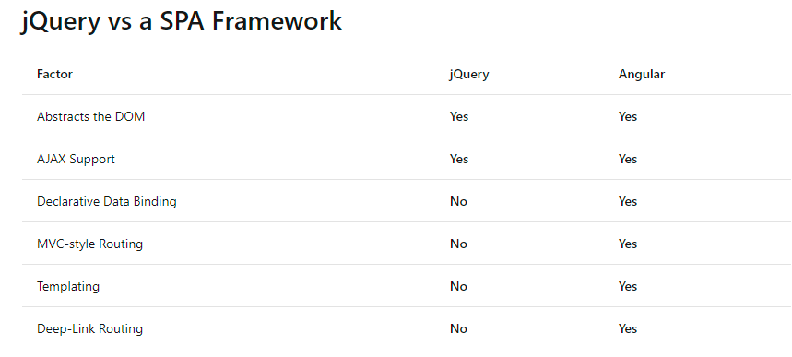

Slide 33
SPA
A single-page application (SPA) is a web application or website that interacts with the user by dynamically rewriting the current web page with new data from the web server, instead of the default method of the browser loading entire new pages. The goal is faster transitions that make the website feel more like a native app.
A single page application, in the simplist of definition, is when a web page is built, well, as a single page. That is when a user clicks to see different content or pages of a website, the communications delivering the content grabs only the content that is different from the originating page, rather than going back to the server, getting, and then displaying the entire page again

Slide 34
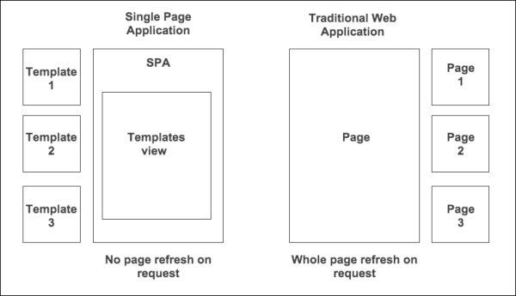

Slide 35
Why use single page applications
There are many advantages to using SPA, all of which depend on goals and the purpose of the site. Some of those advantages include:
More responsive, fluid user experience (after the initial page load).
Ability to use existing APIs.
Simpler development = faster go to market.
Enables offline access to content.
SPAs are easy to debug
It’s easier to make a mobile application.
SPA can cache any local storage effectively.
SPA separates UI and data.

Slide 36
Angular SPAs
Angular remains one of the world's most popular JavaScript frameworks. Since Angular 2, the team rebuilt the framework from the ground up (using TypeScript) and rebranded from the original AngularJS name to angular. Now several years old, the redesigned Angular continues to be a robust framework for building Single Page Applications.
Angular applications are built from components. Components combine HTML templates with special objects and control a portion of the page. A simple component from Angular's docs is shown here:
JavaScript
import { Component } from '@angular/core';
@Component({
selector: 'my-app',
template: `<h1>Hello {{name}}</h1>`
})
export class AppComponent { name = 'Angular'; }

Slide 37
Components are defined using the @Component decorator function, which takes in metadata about the component. The selector property identifies the ID of the element on the page where this component will be displayed. The template property is a simple HTML template that includes a placeholder that corresponds to the component's name property, defined on the last line.
By working with components and templates, instead of DOM elements, Angular apps can operate at a higher level of abstraction and with less overall code than apps written using just JavaScript (also called "vanilla JS") or with jQuery. Angular also imposes some order on how you organize your client-side script files. By convention, Angular apps use a common folder structure, with module and component script files located in an app folder. Angular scripts concerned with building, deploying, and testing the app are typically located in a higher-level folder.
You can develop Angular apps by using a CLI. Getting started with Angular development locally (assuming you already have git and npm installed) consists of simply cloning a repo from GitHub and running npm install and npm start. Beyond this, Angular ships its own CLI, which can create projects, add files, and assist with testing, bundling, and deployment tasks. This CLI friendliness makes Angular especially compatible with ASP.NET Core, which also features great CLI support.

Slide 38
React
Unlike Angular, which offers a full Model-View-Controller pattern implementation, React is only concerned with views. It's not a framework, just a library, so to build a SPA you'll need to leverage additional libraries. There are a number of libraries that are designed to be used with React to produce rich single page applications.
One of React's most important features is its use of a virtual DOM. The virtual DOM provides React with several advantages, including performance (the virtual DOM can optimize which parts of the actual DOM need to be updated) and testability (no need to have a browser to test React and its interactions with its virtual DOM).
React is also unusual in how it works with HTML. Rather than having a strict separation between code and markup (with references to JavaScript appearing in HTML attributes perhaps), React adds HTML directly within its JavaScript code as JSX. JSX is HTML-like syntax that can compile down to pure JavaScript. For example:
<ul>
{ authors.map(author =>
<li key={author.id}>{author.name}</li>
)}
</ul>

Slide 39
If you already know JavaScript, learning React should be easy. There isn't nearly as much learning curve or special syntax involved as with Angular or other popular libraries.
Because React isn't a full framework, you'll typically want other libraries to handle things like routing, web API calls, and dependency management. The nice thing is, you can pick the best library for each of these, but the disadvantage is that you need to make all of these decisions and verify all of your chosen libraries work well together when you're done. If you want a good starting point, you can use a starter kit like React Slingshot, which prepackages a set of compatible libraries together with React.

Slide 40
Choosing a SPA Framework
When considering which option will work best to support your SPA, keep in mind the following considerations:
Is your team familiar with the framework and its dependencies (including TypeScript in some cases)?
How opinionated is the framework, and do you agree with its default way of doing things?
Does it (or a companion library) include all of the features your app requires?
Is it well documented?
How active is its community? Are new projects being built with it?
How active is its core team? Are issues being resolved and new versions shipped regularly?
Frameworks continue to evolve with breakneck speed. Use the considerations listed above to help mitigate the risk of choosing a framework you'll later regret being dependent upon. If you're particularly risk-averse, consider a framework that offers commercial support and/or is being developed by a large enterprise.

